Slide 1
Rockbuster Stealth
Online Video rental service launch plan

Slide 2
Rockbuster Stealth online movie rental launch plan
Rockbuster Stealth must position itself for long-term sustainability leveraging a new online video rental service to remain competitive.
This analysis aims to:
Understand Rockbuster Stealth’s current rental statistics
Provide guidance on target movie, customer, and region selections
Define a plan for a successful launch of this new service
To address this, several questions will be answered:
Which movies have contributed to revenue growth most and least?
What is the average rental duration?
What countries have Rockbuster customers?
Where are the customers that have a high lifetime value?
Do sales figure vary across different geographic regions?

Slide 3
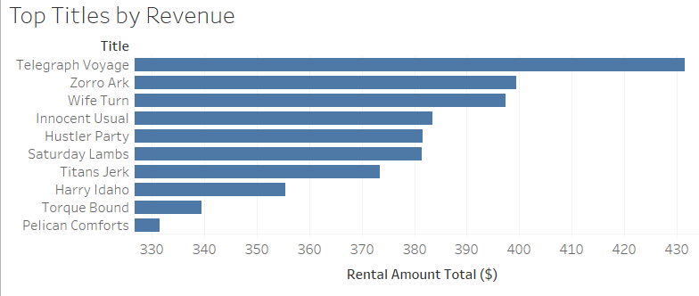
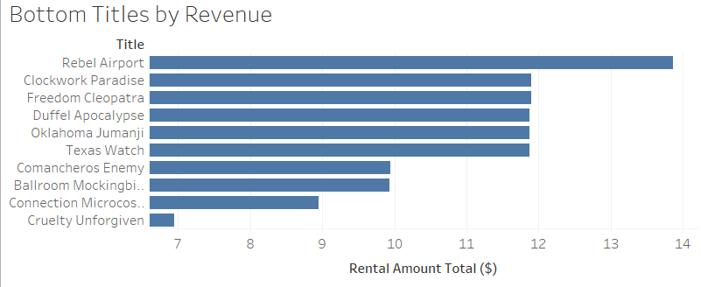
Revenue by Movie Title
Movies with low revenue should be removed to redirect licensing fees to more successful titles
Top titles should be given focus when selecting movies for initial launch

Slide 4
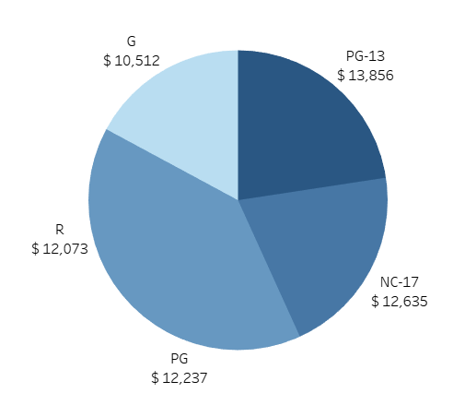

Revenue by Rating
Rating should be considered during movie selection.
PG-13 is Rockbuster’s highest grossing rating followed by NC-17
G rated movies produce the least revenue

Slide 5
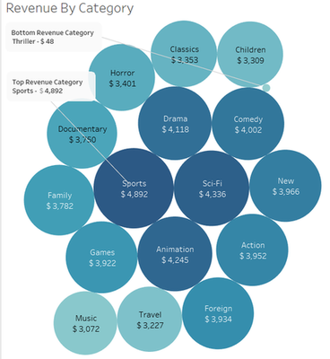
Revenue by Category
Sports, Sci-Fi, and Animation lead in revenue
Music, Travel, and Thriller categories could be considered to eliminate

Slide 6


Average Rental Duration
Average rental duration:
4 days all categories
6 days for Thriller
Average rental duration is 4 days.
Rockbuster should consider this when establishing:
Rental policies
‘per rental’ OR ‘per view’ pay structure
If and When to include late fees
Rental duration ranges from 3 to 7 days

Slide 7
Additional film metrics
Rental Rates
Film Durations
Average rental rate: $2.98
Lowest rental rate: $0.99
Highest rental rate: $4.99
Average film: 115 minutes
Shortest film: 46 minutes
Longest film: 185 minutes

Slide 8
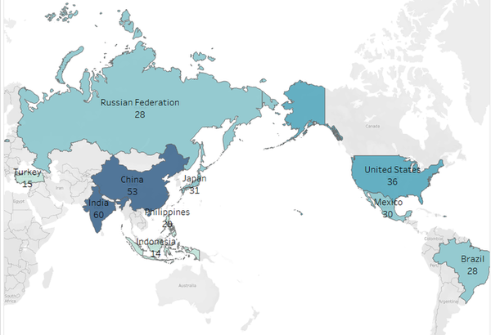
Top 10 Countries with Rockbuster Customers
Top cities within these countries
Brazil - So Leopoldo
China - Shanwei
China - Tianjin
India - Ambattur
Indonesia - Cianjur
Japan - Iwaki
Mexico - Acua
Russian Federation - Teboksary
United States - Aurora
United States - Citrus Heights
India and China lead in customer count
United States, Japan, and Mexico follow close behind

Slide 9
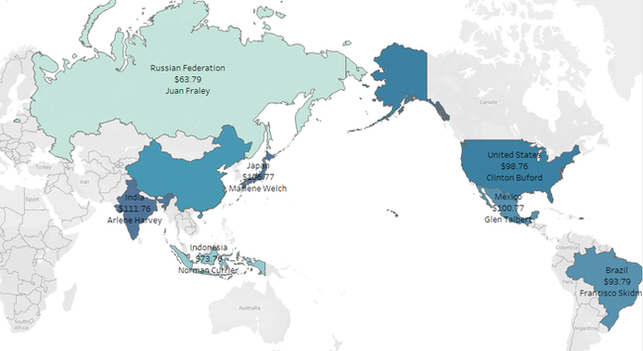
Top 10 Customer Locations
Rockbuster’s top 10 Customers with high Lifetime Value (LTV) are consistently located in the top revenue countries.

Slide 10
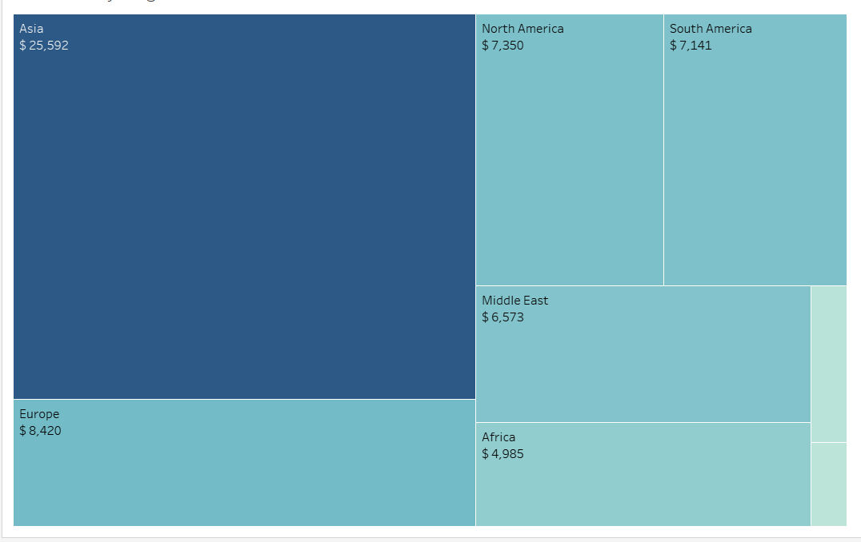
Revenue by Geographic Region
Asia is Rockbuster’s top region for revenue by a significant margin.
Europe, North America, and Middle East follow behind Asia
* Countries grouped to regions per the UN region designations

Slide 11
Movie Selection for Launch
Secure additional licensing for top revenue producing movies
Known high revenue movies should be promoted in all regions
Review and revise rental plan
Eliminate late fees
Establish either a ‘per rental’ OR ‘per view’ fee structure
Emphasis should be given to:
PG-13, NC-17, and PG rated movies
Sports, Sci-Fi, and Animation categories
To minimize licensing fees and give focus to high revenue rentals:
Reduce emphasis on R and G rated movies
Eliminate Music, Travel, and Thriller categories

Slide 12
Countries and Customers for Launch
Continue to support countries with a solid customer base
India, China, United States, Japan, Mexico are top 5 in revenue
Bolster marketing in other top 10 countries
Russian Federation, Brazil, Philippines, Turkey, Indonesia
The top 10 Customers are within these top 10 countries.
Implement loyalty programs to acquire new and retain existing customers
Post-launch, assess other countries within the top revenue regions for additional marketing campaigns
Asia, Europe, North America

Slide 13
Feedback and Data
Feedback, comments, and questions are welcome
mattredleifdev@gmail.com
Data and queries

Slide 14
Tableau Visualizations
Tableau assets
https://public.tableau.com/app/profile/matt8142/viz/MJF-3_10Submission/TopTitlesByRevenue?publish=yes
https://public.tableau.com/app/profile/matt8142/viz/MJF-3_10Submission/BottomTitlesByRevenue?publish=yes
https://public.tableau.com/app/profile/matt8142/viz/MJF-3_10Submission/RevenueByRating?publish=yes
https://public.tableau.com/app/profile/matt8142/viz/MJF-3_10Submission/RevenueByCategory?publish=yes
https://public.tableau.com/app/profile/matt8142/viz/MJF-3_10Submission/CustomerCount-TopCountries?publish=yes
https://public.tableau.com/app/profile/matt8142/viz/MJF-3_10Submission/Top10CustomerLocations?publish=yes
https://public.tableau.com/app/profile/matt8142/viz/MJF-3_10Submission/RevenueByRegion?publish=yes

